Slide 1
Renewable energy sources in Italy

Slide 2
Introduction
The statistical report data for 2014 have revealed that these recent years have been characterized by significant growth in the use of renewable energy, the main reason is given by both incentives and subsidies. In fact in 2014, in Italy the systems powered by renewable sources reached 656,000 units with a total installed capacity to 50,595 MW (Mega is a unit prefix in metric systems of units denoting a factor of one million 10⁶ or 1000000) .

Slide 3
contents
Installed capacity of system using renewable sources
Production of eletricity
The evolution of renewable sources
Solar PV
Wind
Hydropower
Bioenergy
Geothermal

Slide 4
Installed capacity in Italy
Between 2001 and 2014, the gross efficient installed capacity in Italy went from 18,724 MW to 50,595 MW, an increase of 31,871 MW with an annual growth average rate of 7.9% total capacity. However the years with the highest capacity increases were 2011 and 2012. This growth is mainly due to:
new wind farms ( +33.3% in the number of systems and +1.7% in installed capacity) and
photovoltaic systems (+8.7% in the number of systems and +2.3% in installed capacity).

Slide 6
Production of energy from renewable sources
Since 2008 the production renewable sources has been setting year by each new records. In 2014, it reached a new record level of 120,679 GWh. Hydropower represented the source that provided the greatest contribution to the production of electricity: with 58,545 GWh it accounted for 48% of the total production from renewable sources, setting a production record. While up to 2008 the trend of electricity generated from renewable sources was mainly driven by the hydro source, in recent years the importance of “new renewables” (solar, wind and bioenergy) has increased, which in 2014 accounted for 52% of national electricity production from renewable sources.

Slide 8
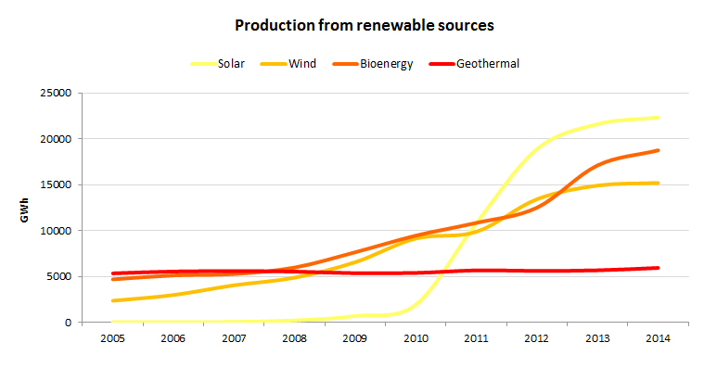
The evolution
This chart makes you better appreciate the evolution of wind, solar, geothermal and biomass sources in the decade from 2004 to 2014.However, in Italy the energy production from renewable sources does not include hydropower.

Slide 9
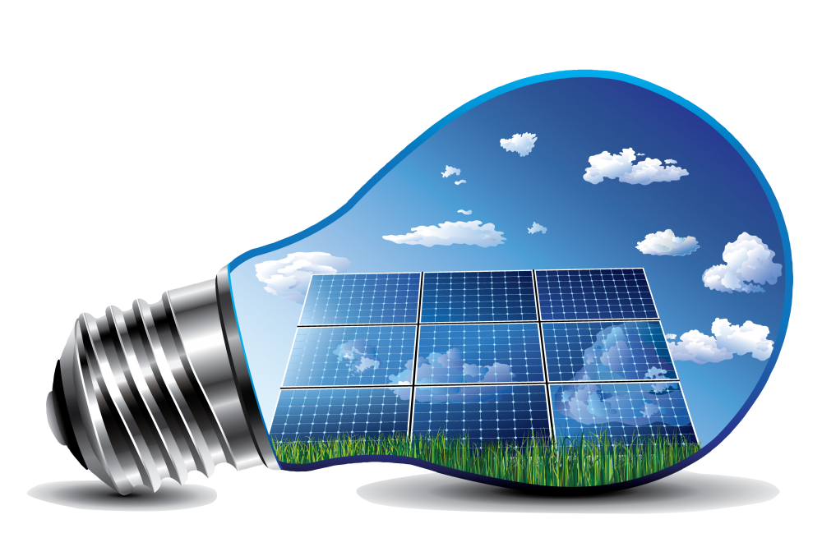
Solar PV
Solar PV systems in Italy in 2014 generated 24,676 GWh of electricity, covering 7.8 % of the country’s electricity mix, according to Terna, Italy's electricity transmission grid operator. That total is significantly higher than the previous year one, when PV systems in Italy had only generated the 21,838 GWh of electricity or the 7% of Italy’s electricity mix. So, in clear GWh numbers, Italy’s electricity generation from PV in 2014 increased by 13 percent compared to 2013

Slide 10
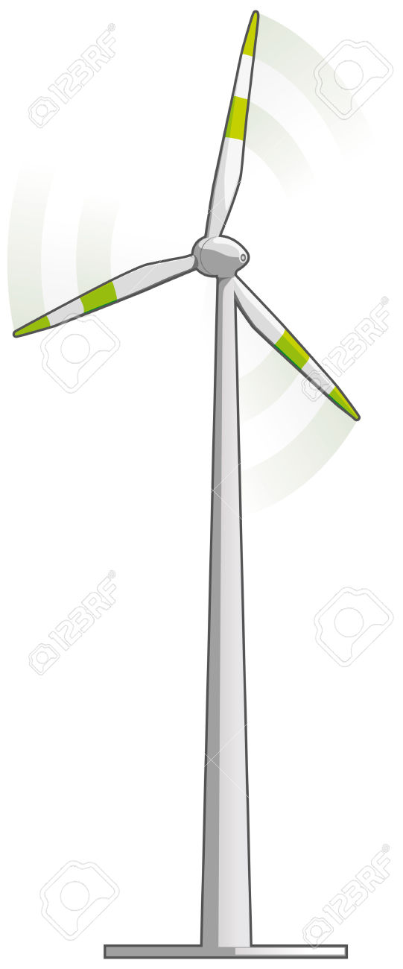
Wind
Wind systems in Italy at the end of 2014 amounted to 1,847 with a total installed capacity of 8,703 MW. 80% of wind farms in Italy are small (capacity of less than 1 MW), while 91% of the installed capacity (7,933 MW) is concentrated in 262 wind farms with capacity exceeding 10 MW. Due to the environmental and territorial characteristics of our country, 96.6% of the installed capacity in Italy and 83.4% of systems are situated in the regions of Southern Italy, where the wind conditions, topography and site accessibility are favourable for the installation of wind farms. As regards electricity production from wind power, in 2014, 15,178GWh were generated, 1.9% more than the previous year. The contribution of wind power to national electricity production in 2014 amounted to 4.7%.

Slide 11
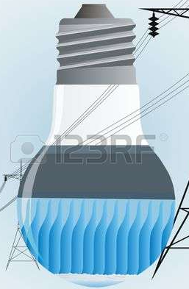
Hydropower
Hydropower systems in Italy at the end of 2014 amounted to 3,432 with a total installed capacity of 18,418 MW. Between 2013 and 2014, the number of systems increased by 5.6%, while the overall increase in terms of installed capacity was only 0.3%. In recent years, therefore, hydropower has not changed significantly, since many small systems have come into operation. At a regional level, 80.2% of hydropower systems are installed in northern Italy. In particular, in Piedmont (709 systems), Trentino Alto Adige (703) and Lombardy (487) there are 55% of the all the systems in Italy.

Slide 12
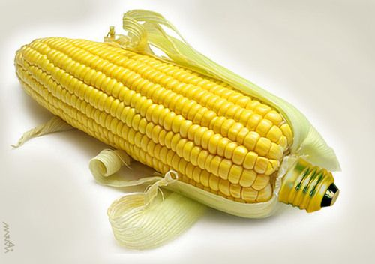
Bioenergy
The term bioenergy indicates that type of energy produced from biomasses (excluding municipal solid waste), biogases and bioliquids. The number of systems using bioenergy in Italy at the end of 2014 amounted to 2,482 with an installed capacity of 4,044 MW (8% of the entire installed renewable capacity).The 75.1% of systems are situated in the north of Italy and, particularly, Lombardy is the region with the highest number of systems (26.5%), followed by Veneto (13.9%). Central Italy accounts for 14.3%, while southern Italy has only the 10.7%.

Slide 13
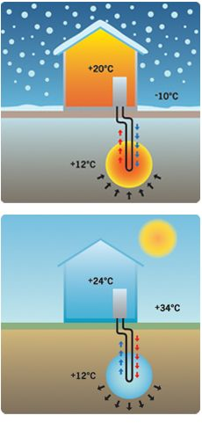
Geothermal
Geothermal systems in Italy at the end of 2014 amounted to 34 plants with a total installed capacity of 821 MW. However these 34 systems in Italy are concentrated in only one region, Tuscany. The geothermal source has been substantially stable over time, representing 5% of the electricity production of the entire installed base of renewable systems and 1.8% of the production of electricity in Italy.

